Slide 1
BOM Processing Tool Alternative Components Update Jesse Jan Caparangca Angelo Manumbali 13/02/2019

Slide 2
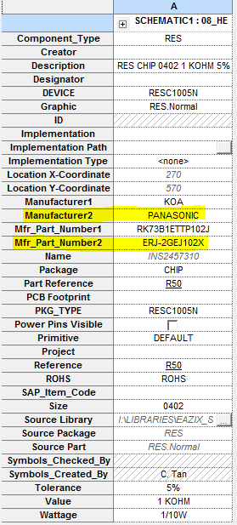
Schematic Capture / Entry
When necessary, add new properties to include alternative component information.
Manufacturer2
Mfr_Part_Number2
Ensure that the alternative component has the exact same values as the original component.
Notes:
2
Notes:
IMI is consistently among the top 30 EMS providers in the whole world. Most important, we are a preferred supplier of a number of global OEMs such as Bosch and Assa Abloy.

Slide 3
Generating the BOM (Text, Tab-Separated)
Set Mode to “Use occurrences (Preferred)” – default setting
Scope can be “Process entire design” or “Process selection”
(UPDATED) Set the Line Item Definition/Header field to:
Item\tQuantity\tReference\tDnD PN\tSAP\tDescription\tManufacturer1\tMPN1\tSAP2\tManufacturer2\tMPN2\tRestrictions\tAssembly Notes
(UPDATED) Set the Line Item Definition/Combined Property String field to:
{Item}\t{Quantity}\t{Reference}\t{EAZIX_Part_Key}\t{SAP_Item_Code}\t{Description}\t{Manufacturer1}\t{Mfr_Part_Number1}\t{""}\t{Manufacturer2}\t{Mfr_Part_Number2}\t{ROHS} {Others}\t{Assembly Notes}
Notes:
3
Notes:
IMI is consistently among the top 30 EMS providers in the whole world. Most important, we are a preferred supplier of a number of global OEMs such as Bosch and Assa Abloy.

Slide 4
CAUTION IN USE
Exercise caution in use. Double check BOM entry outputs.
Always review BOMs.
Report any errors encountered.
Notes:
4
Notes:
IMI is consistently among the top 30 EMS providers in the whole world. Most important, we are a preferred supplier of a number of global OEMs such as Bosch and Assa Abloy.

Slide 5
THANK YOU

